Slide 1

Fake Job Postings
Erra
Stark
Ky Nam
Wai Yeong

Slide 2
Objective problem statement
Prevent time wasted and loss of personal data to fake job postings
How to differentiate between fake and genuine job postings?
What constitutes a fake job posting?
Class prediction (Binary)
What is the probability of data point being real or fake?
What model would best fit?
Which features are more important?

Slide 3
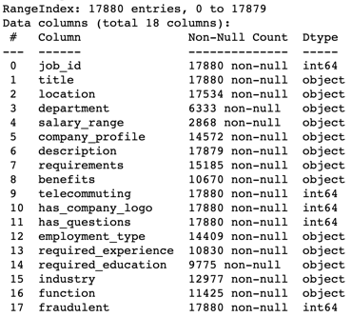
Where to start?
Unstructured

Slide 4
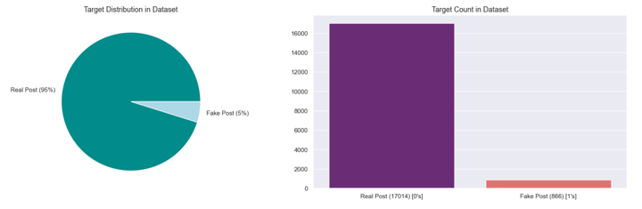
Exploratory analysis (Fradulent)
Large imbalance of fraudulent (minority) versus real (majority) data
1:19

Slide 5
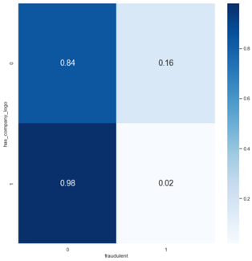
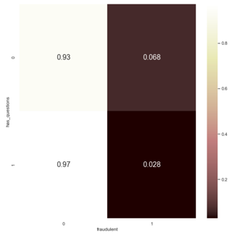
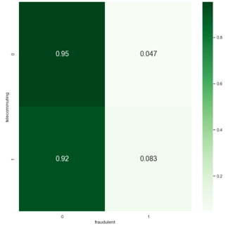
Exploratory analysis (Boolean)
Has company logo
Has questions
Telecommuting
Poor differentiators of posting fraudulence
Slight exception for company logo

Slide 6
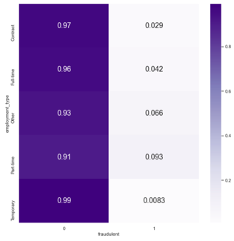
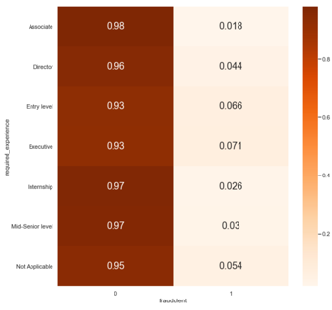
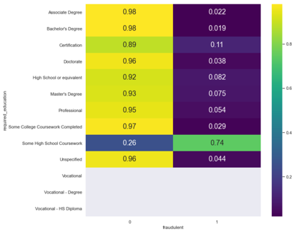
Exploratory analysis (multiclass)
Employment type
Required experience
Required education
Poor differentiators of posing fraudulence
Except for required education

Slide 7
Exploratory analysis (multiclass)
Top 10 most common job titles and functions for fake jobs
Fake posting titles tend to require:
Administrative skills
Real posting titles tend to suggest:
Domain specific skills
Top 10 most common job titles and functions for real jobs

Slide 8
Exploratory analysis (multiclass)
Top Fake job industries
Discrepancy in industry which fake job postings tend to target
Oil & Energy
Accounting
Real Estate
Tourism
Top Real job industries

Slide 9
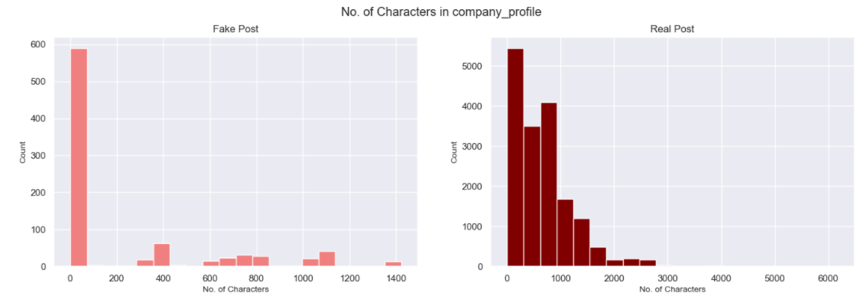
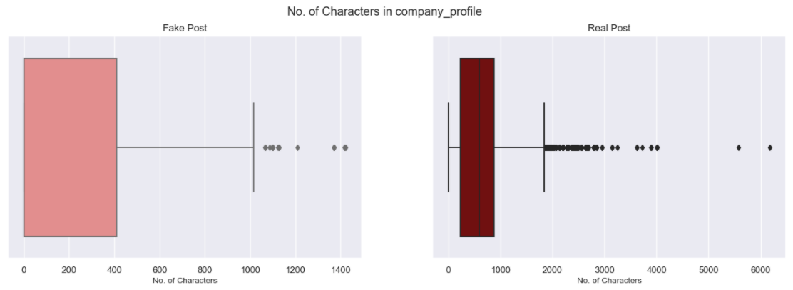
Exploratory analysis (Company profile)

Slide 10
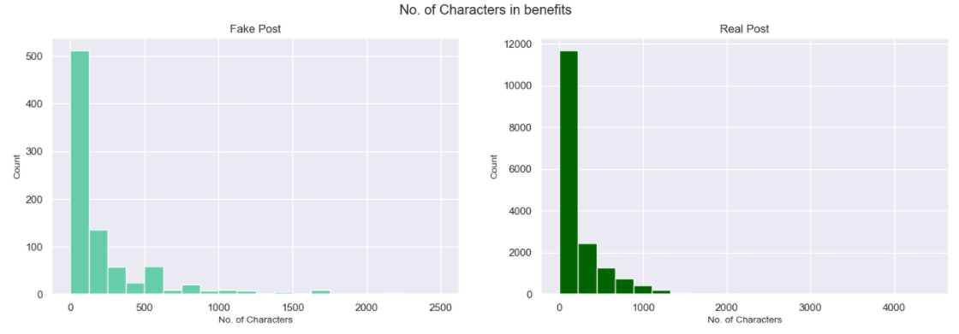
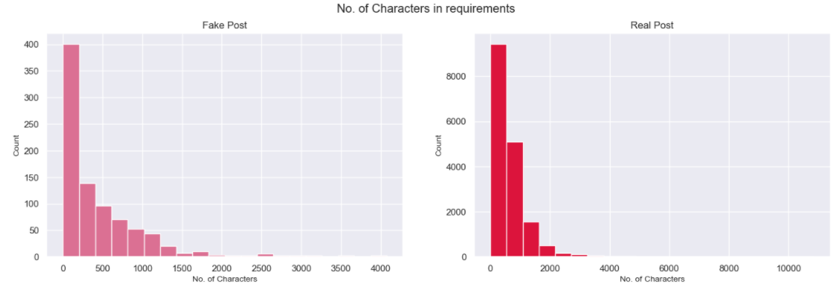
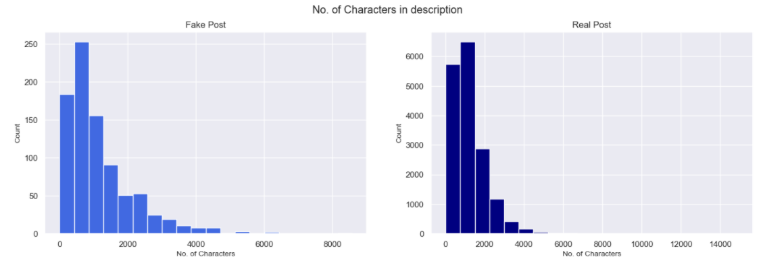
Exploratory analysis
(Description, Requirements, Benefits)

Slide 11
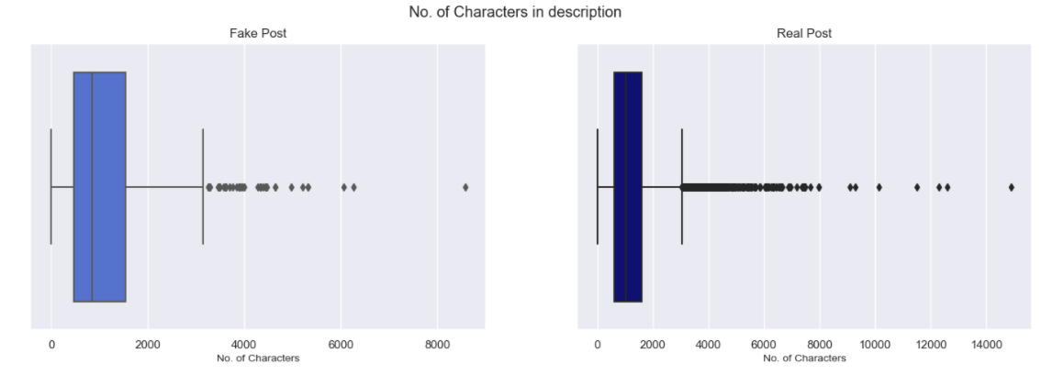
Exploratory analysis (Description)

Slide 12
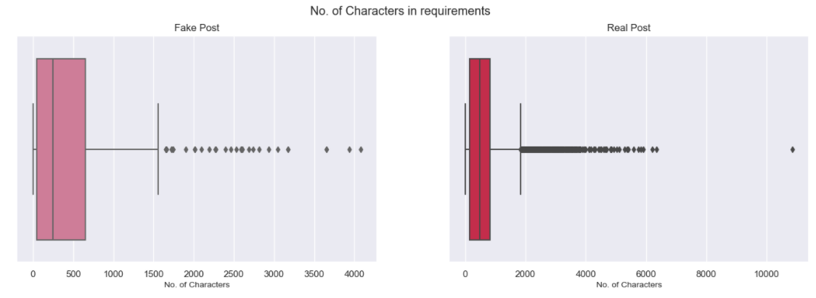
Exploratory analysis (Requirements)

Slide 13
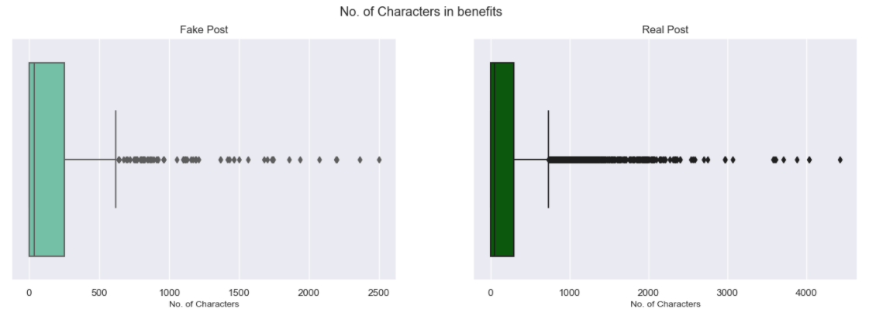
Exploratory analysis (Benefits)

Slide 14
EXPLORATORY ANALYSIS (COMMON WORDS)
Word cloud real jobs
Word cloud fake jobs

Slide 15
Unstructured (fill-in form)
Improper punctuation > learn.with
Non-ascii values > ϒ (Greek)
Non-breaking spaces > \xa0
“nan” wordings > nannanmarketing
Links > url_XXX
Contact number > phone_XXX
Emails > email_XXX
Spelling & grammatical errors

Slide 16

Data cleaning & preparation

Slide 17

Data cleaning - Language pipeline
Lower case
Strip word of leading and trailing symbols and numbers
Removal of punctuations
Removal of stop words
Preserve and shorten links, emails, contact numbers (url_xxx > url_
Preserve non_ascii and non_breaking spaces (/xa0 > non_breaking_space)
Tag words with their word class
Adjectives
Adverbs
Verbs
Nouns
Lemmatization
Reduce inflectional forms and derivationally related forms of a word to a common base form

Slide 18

Data cleaning - Categorical pipeline
Convert to lowercase
Replace spaces and dashes with underscore
Separate location into country and city
Convert binary features into objects
Director > director
mid-senior level > mid_senior_level
US, NY, New York > US and NY, New York
Telecommuting: 0 > not_telecommuting

Slide 19

Data cleaning - Null pipeline
Convert occurrences of “nan” into feature specific nan values
Location: nan > nan_location
Education: nan > unspecified_education

Slide 20

Data Preparation - Feature generation
Additional features:
Character length of prose features of job postings
Company_profile, Description, Requirements, Benefits

Slide 21

Data Preparation - Vectorization
Count Vectorizer
Frequency of word occurrence
Compressed Sparse Row Matrix
Compress the row indices of a matrix whose most elements are 0
Smaller space and faster access

Slide 22

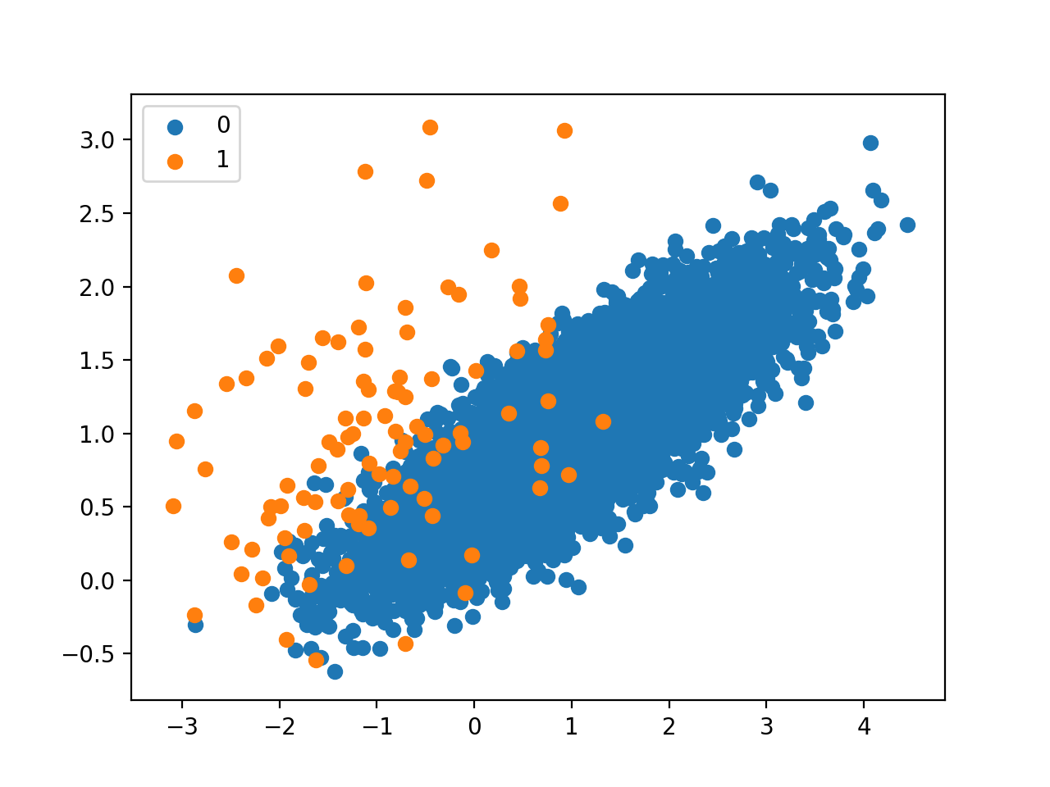
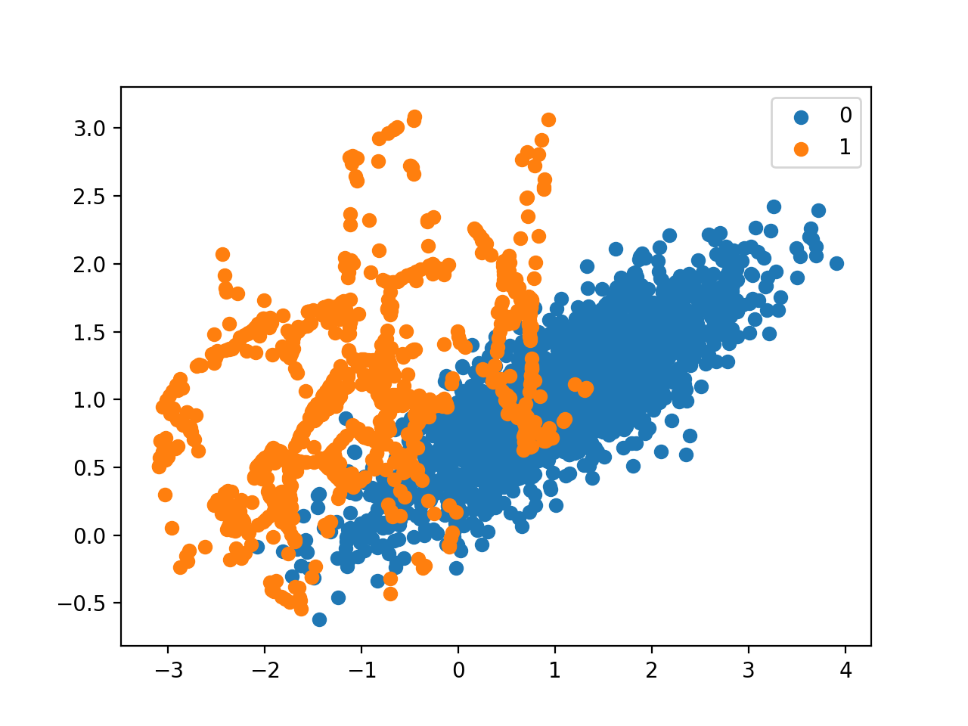
Data Preparation - Data Augmentation
Synthetic Minority Oversampling Technique (SMOTE)
Synthesizing new data through interpolation of minority class
Random Undersampling
Under sampling of majority class

Slide 23

Machine Model

Slide 24
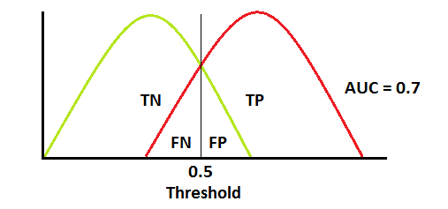
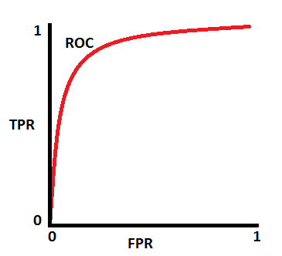
Metric AUC-ROC
Large data imbalance > Accuracy and Precision works poorly
Assuming all data are classified as real, accuracy of 0.95 achieved
AUC-ROC- accounts for results of confusion matrices for different threshold of classification

Slide 25

Machine Learning Models
Naïve Bayes
Support Vector Machine (Kernel)
Random Forest
Neural Network - Tensorflow

Slide 26
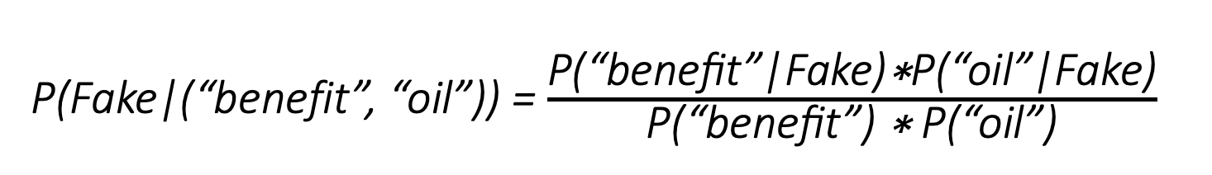
Naive Bayes
Simple probabilistic classifier
Assumes that all features are independent of one another
Frequency of word occurrence in prose is directly linked to probability
P(Fake|(“benefit”, “oil”)) = $\frac{\text{P}\text{(“}\text{benefit}\text{”|}\text{Fake}\text{)∗}\text{P}\text{(“}\text{oil}\text{”|}\text{Fake}\text{)}}{\text{P}\text{(“}\text{benefit}\text{”) ∗ }\text{P}\text{(“}\text{oil}\text{”)}}$

Slide 27

SVM (Kernel)
Construction of hyperplane that best separates data
Use of kernel to map data points to a higher dimension
Linear (best)
Polynomial
Sigmoid

Slide 28
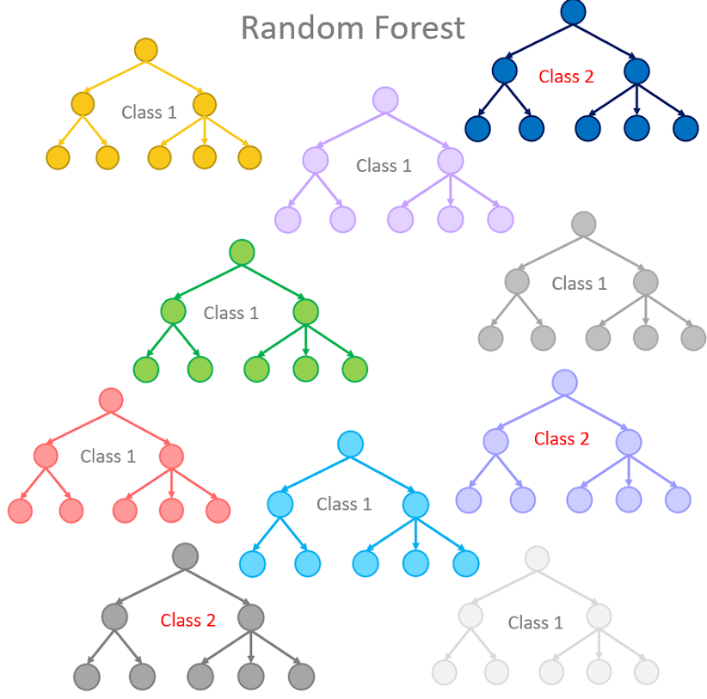
Random Forest
Large number of decision trees that operate as an ensemble
Depth (130)
Greater depth, better fit the data by considering more features
When depth is too large, overfits the data

Slide 29
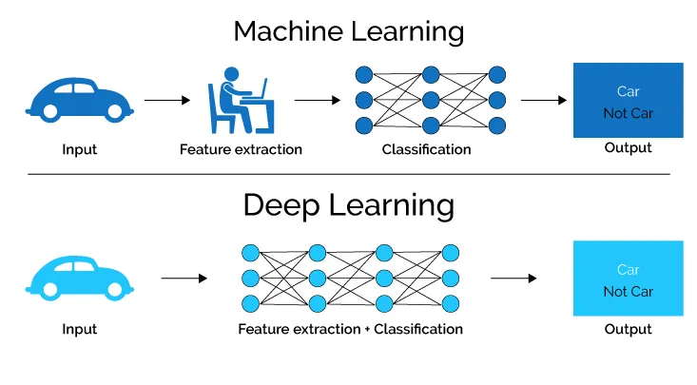
Neural Network
Tensorflow Keras
Notes:
Attempts to recognize underlying relationships in a set of data through a process that mimics the way the human brain operates

Slide 30
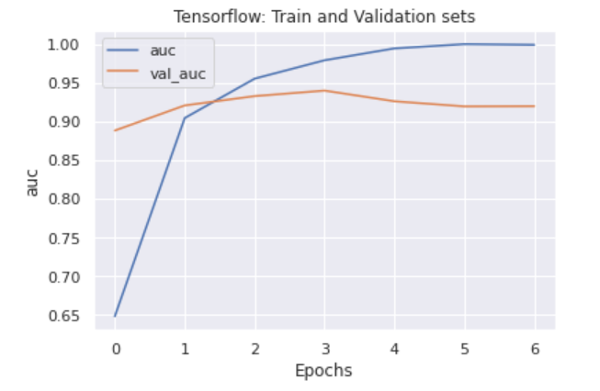
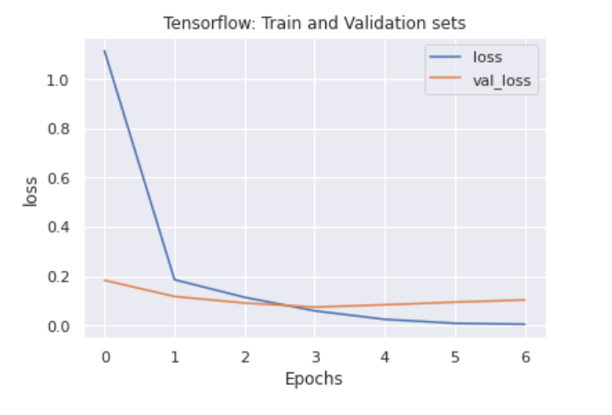
Neural Network: Overfitting
Train AUC vs. Validation AUC
Validation loss vs. Train loss

Slide 31
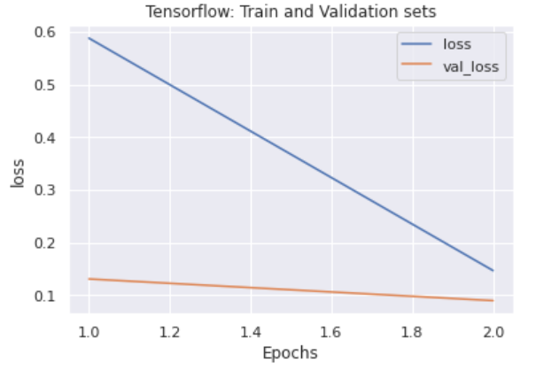
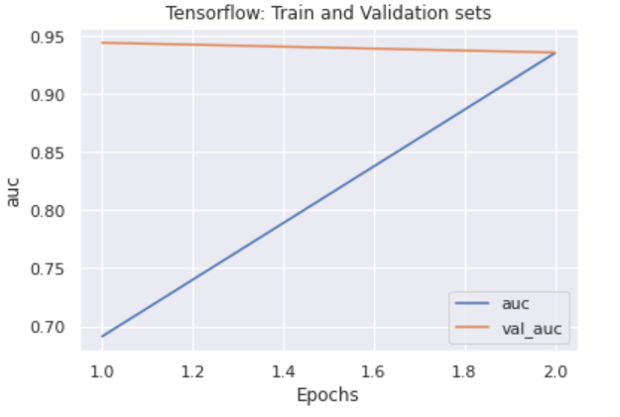
Neural Network: Avoiding overfitting
Reduce complexity of model
Reduce number of epochs (2)
Use fewer layers (2)
Early Stopping callback
Monitor validation loss
Use Dropout function

Slide 32
Results

Slide 33
PERFORMANCE OF MODELS

Slide 34
Importance of feature predictors
Important:
Company_profile
Industry
Function
Not important:
Boolean Variables
Categorical Variables
Non-breaking spaces
Non-ascii values
Notes:
Non-breaking spaces and non-ascii values probably came about due to input format and errors on the side of the job posting site’s database handler
Company profile proved to be the greatest differentiator
This might suggests that fake job posters feel that company profile do not play as significant a role to a job finder than requirements, description and benefits, thus putting in less effort to mask their intent.
Boolean and categorical variables did not play a large part in differentiating due to how their values skewed towards real job postings regardless of their classes
Even required education which supposedly does help, did not prove as a good differentiator due to the little number of data points with non-null values.

Slide 35
Contributions
Erra | Data exploration & visualisation
Ky Nam | Machine Learning- Naïve Bayes & SVM
Stark | Data exploration, cleaning & preparation
Wai Yeong | Machine Learning- Neural network

Slide 36
Thank you

